Slide 1
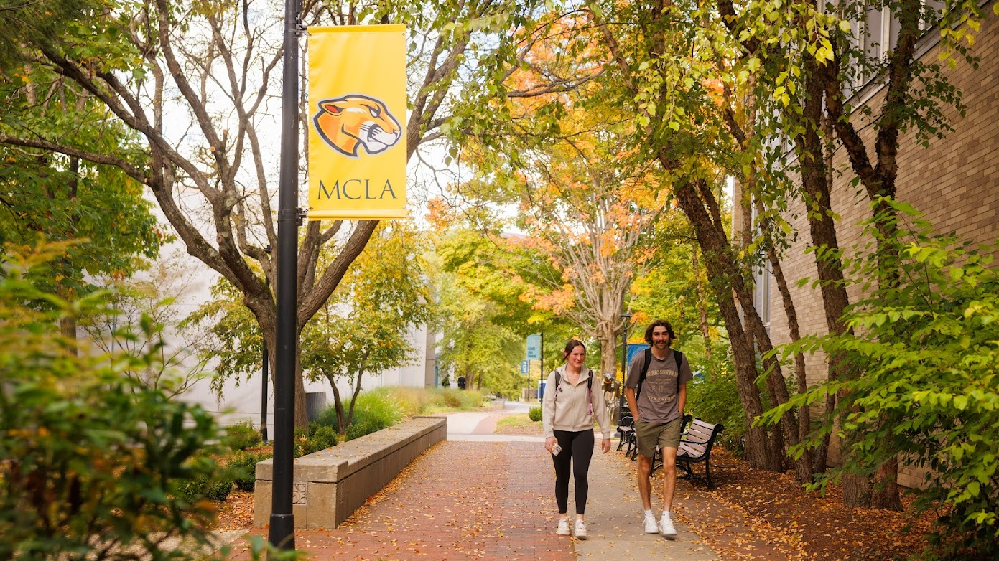
MCLA Strategic Planning 2025-2030
FINDING OUR VOICE
May 2026 Campus Update

Slide 2
Overview
Opportunities, challenges, and achievements
“Guided by our distinctive public liberal arts mission, this strategic plan reflects MCLA’s deep commitment to academic excellence, innovation, and belonging. The plan represents a call to action, urging us all to challenge assumptions, think creatively about our work, and act strategically in pursuit of our shared goal of making MCLA a stronger, more accessible and student-centered institution.”
President James F. Birge
Notes:
PJB Welcome – SP overview

Slide 3
Planning Process
Participation
Nearly 600 MCLA community members participated in the strategic planning process with close to 1,000 data points collected
More than 75 MCLA community members are currently participating in the strategic planning working groups
Project leaders are engaging additional campus colleagues in their work, creating an inclusive process
Notes:
Carolyn

Slide 4
Institutional Planning Timeline
2021 - 2028
Pathways Campaign
2021-2026
NECHE 10 Year Review
2022-2032
Strategic Planning
2025-2030
Strategic Facilities Planning
2025-2026
Strategic Partnerships
with NISS and Gardner Institute
2026-2027
NECHE Interim Report
2027-2028
Notes:
Patrick

Slide 5
Plan Highlights
Goal 1: Distinctive liberal arts mission: Refine and promote MCLA’s distinctive public liberal arts mission and vision in response to the evolving role of higher education and align key institutional decisions and resources accordingly
Goal 2: Increase access, belonging, and success: Build responsive and sustainable institutional structures and practices to increase access, belonging, and success for all members of the MCLA community, with particular focus on those traditionally excluded from higher education
Goal 3: Enhance the student experience: Strengthen and develop innovative initiatives that enhance the holistic student experience and cultivate a campus culture responsive to student voice
Notes:
Jason

Slide 6
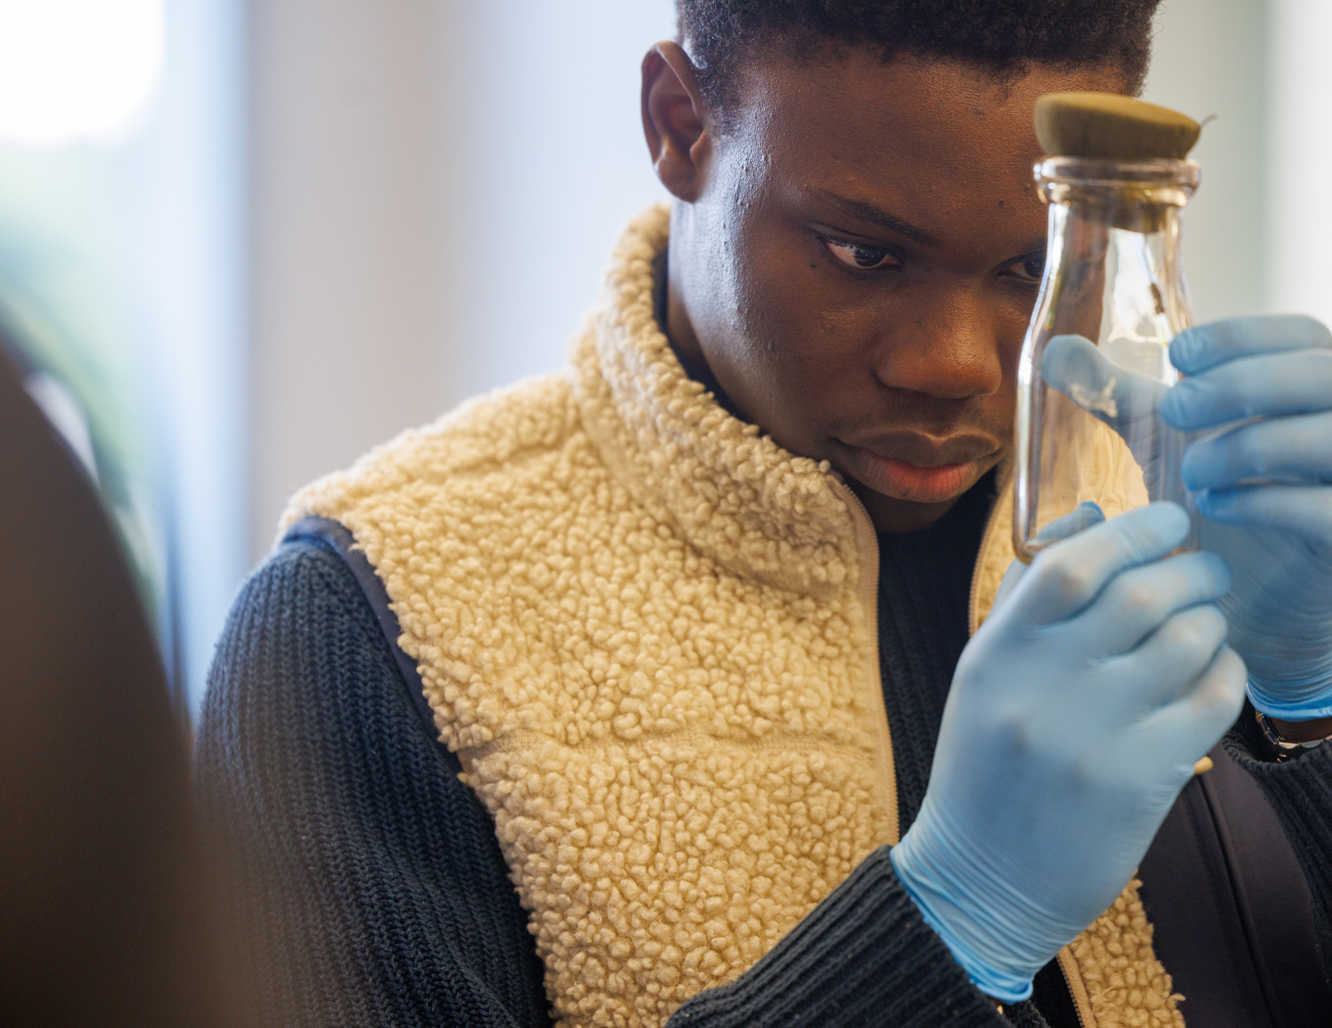
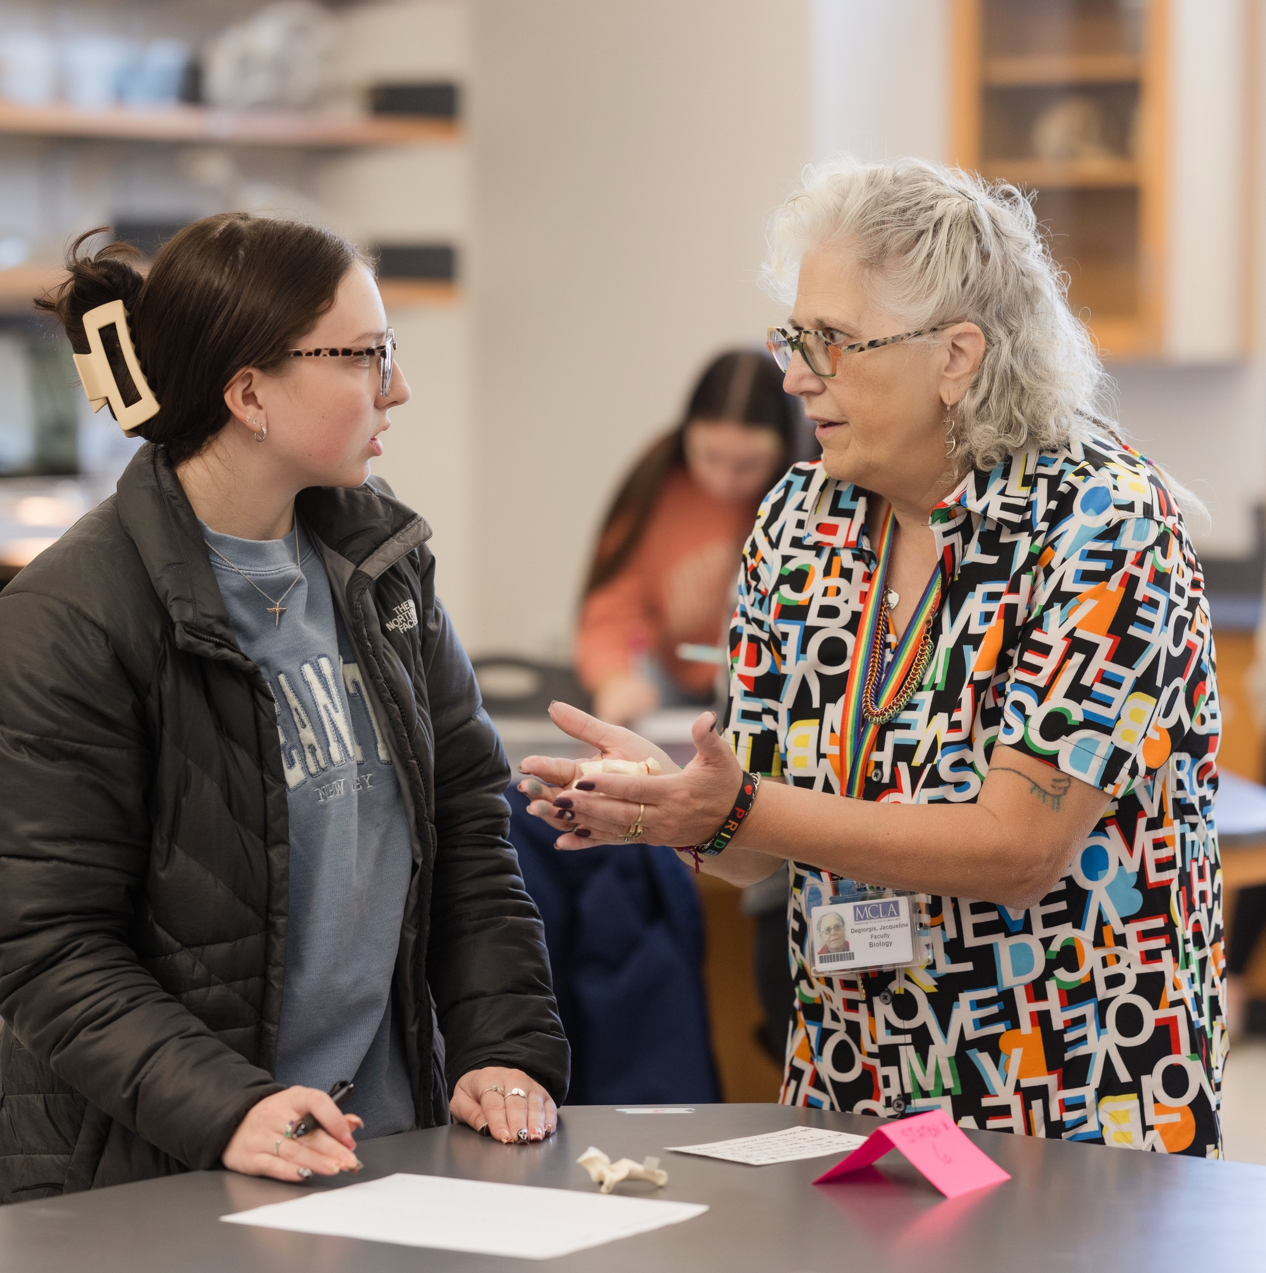
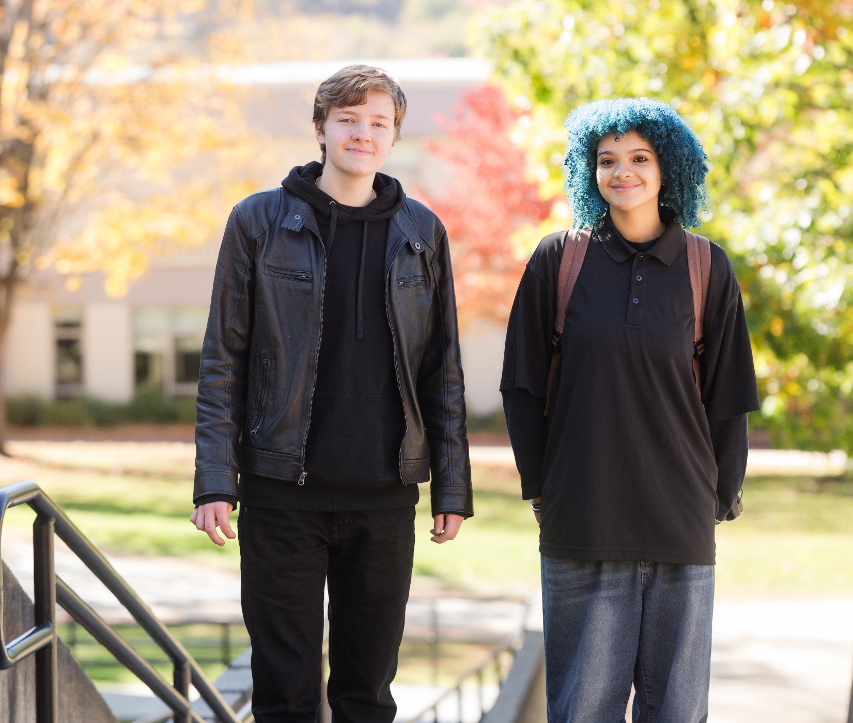
Financial Update
Board budget is regularly monitored to ensure appropriate spending
Tracking SUCCESS funds to ensure funds are utilized to support student success and engagement in support of the plan
Built the FY 27-28 Strategic Planning budget
Monitoring DCAMM (Bright Grant) funding opportunities to support campus upgrades
Included Advancement on Oversight Committee
Notes:
Josh

Slide 7
Goal Teams
Participation
Goal 1
Jana Boyer
Carolyn Dehner
Bernadette Alden
Lynette Bond
Maggie Clark
Jen Dix
Mike Gladu
Tia Kareh
Doreen Kleinman
Masyn Lavariere
Kristin Nichols
Jami Pytko
Laura Standley
Goal 2
Patrick Connelly
Lynn C. White Cloud
Emily Alling
John Clark
Ashleigh Hala
Cindy MacDonald
Arianna Marroquin
Spencer Moser
Kerri Nicoll
Nicole Porther
Brenda Stokes
April Wright
Goal 3
Laura Mooney
Luke Morrill
Eva Bassallo
Jerel Dydowicz
Bob Fortini
Jenn Labbance
Valen Freitas
Whitney Gecker
Justin Golub
Brendon Goodridge
Elizabeth Harris
Brendan Kelly
Justina Trova

Slide 8
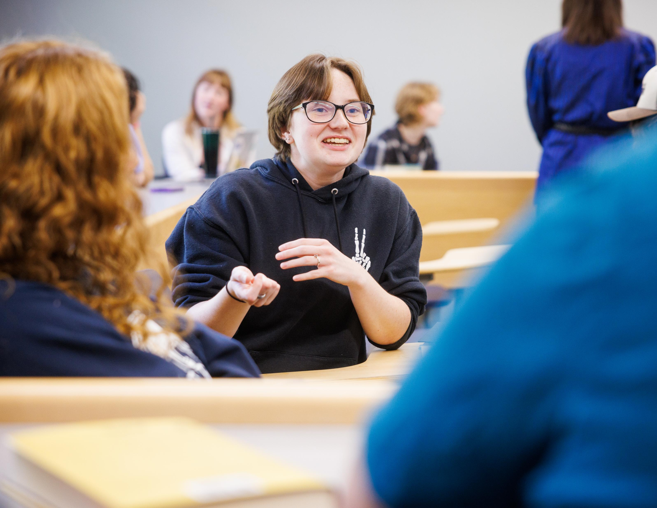
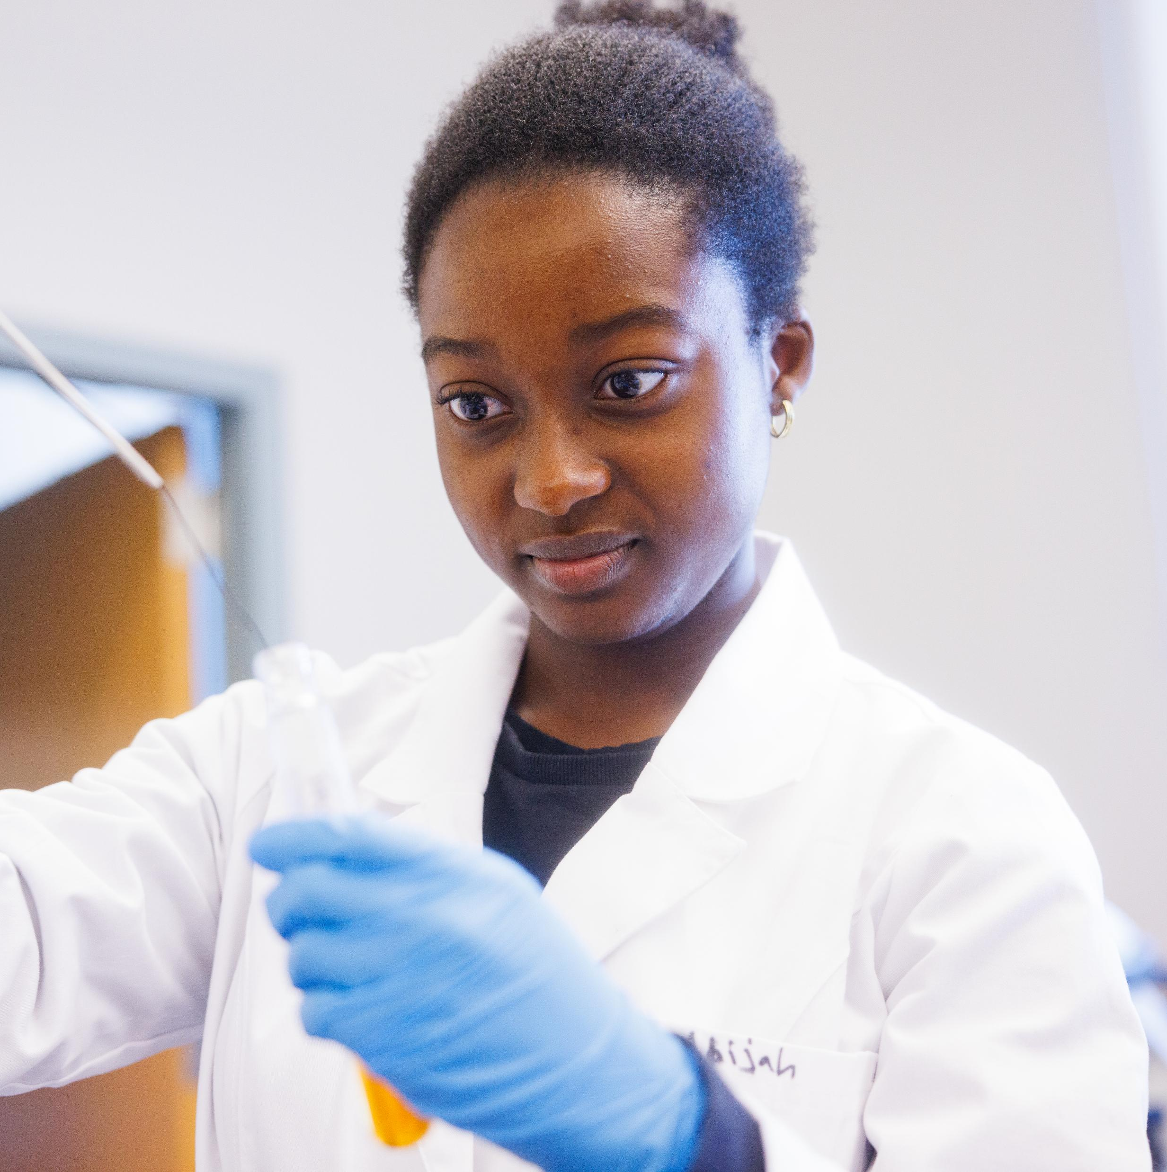
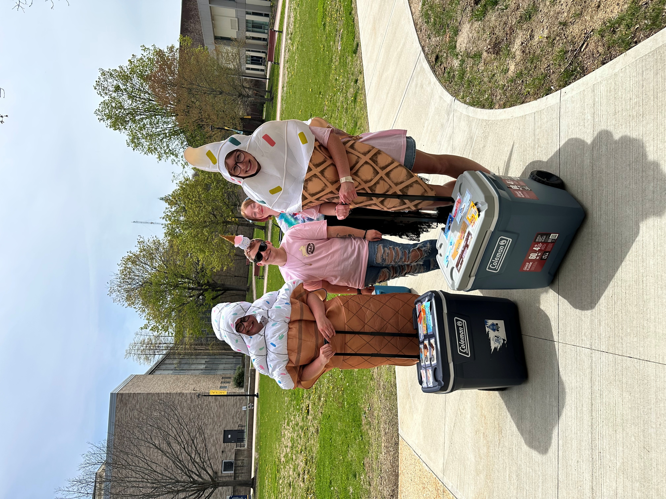
Goal 1: Liberal Arts Mission
Updated mission statement draft developed to share with the MCLA community
Advanced a draft of institutional learning outcomes to share with the community
Conducted a full institutional website audit and optimization initiative
Transformed social media into a managed institutional engagement and reputation channel with measurable impact
Launched targeted streaming and connected digital campaign focused specifically on admitted students adding a yield optimization layer to the funnel
Created a scalable, multi-channel content engine that supports recruitment, yield, and brand storytelling
Notes:
Carolyn/Jana

Slide 9


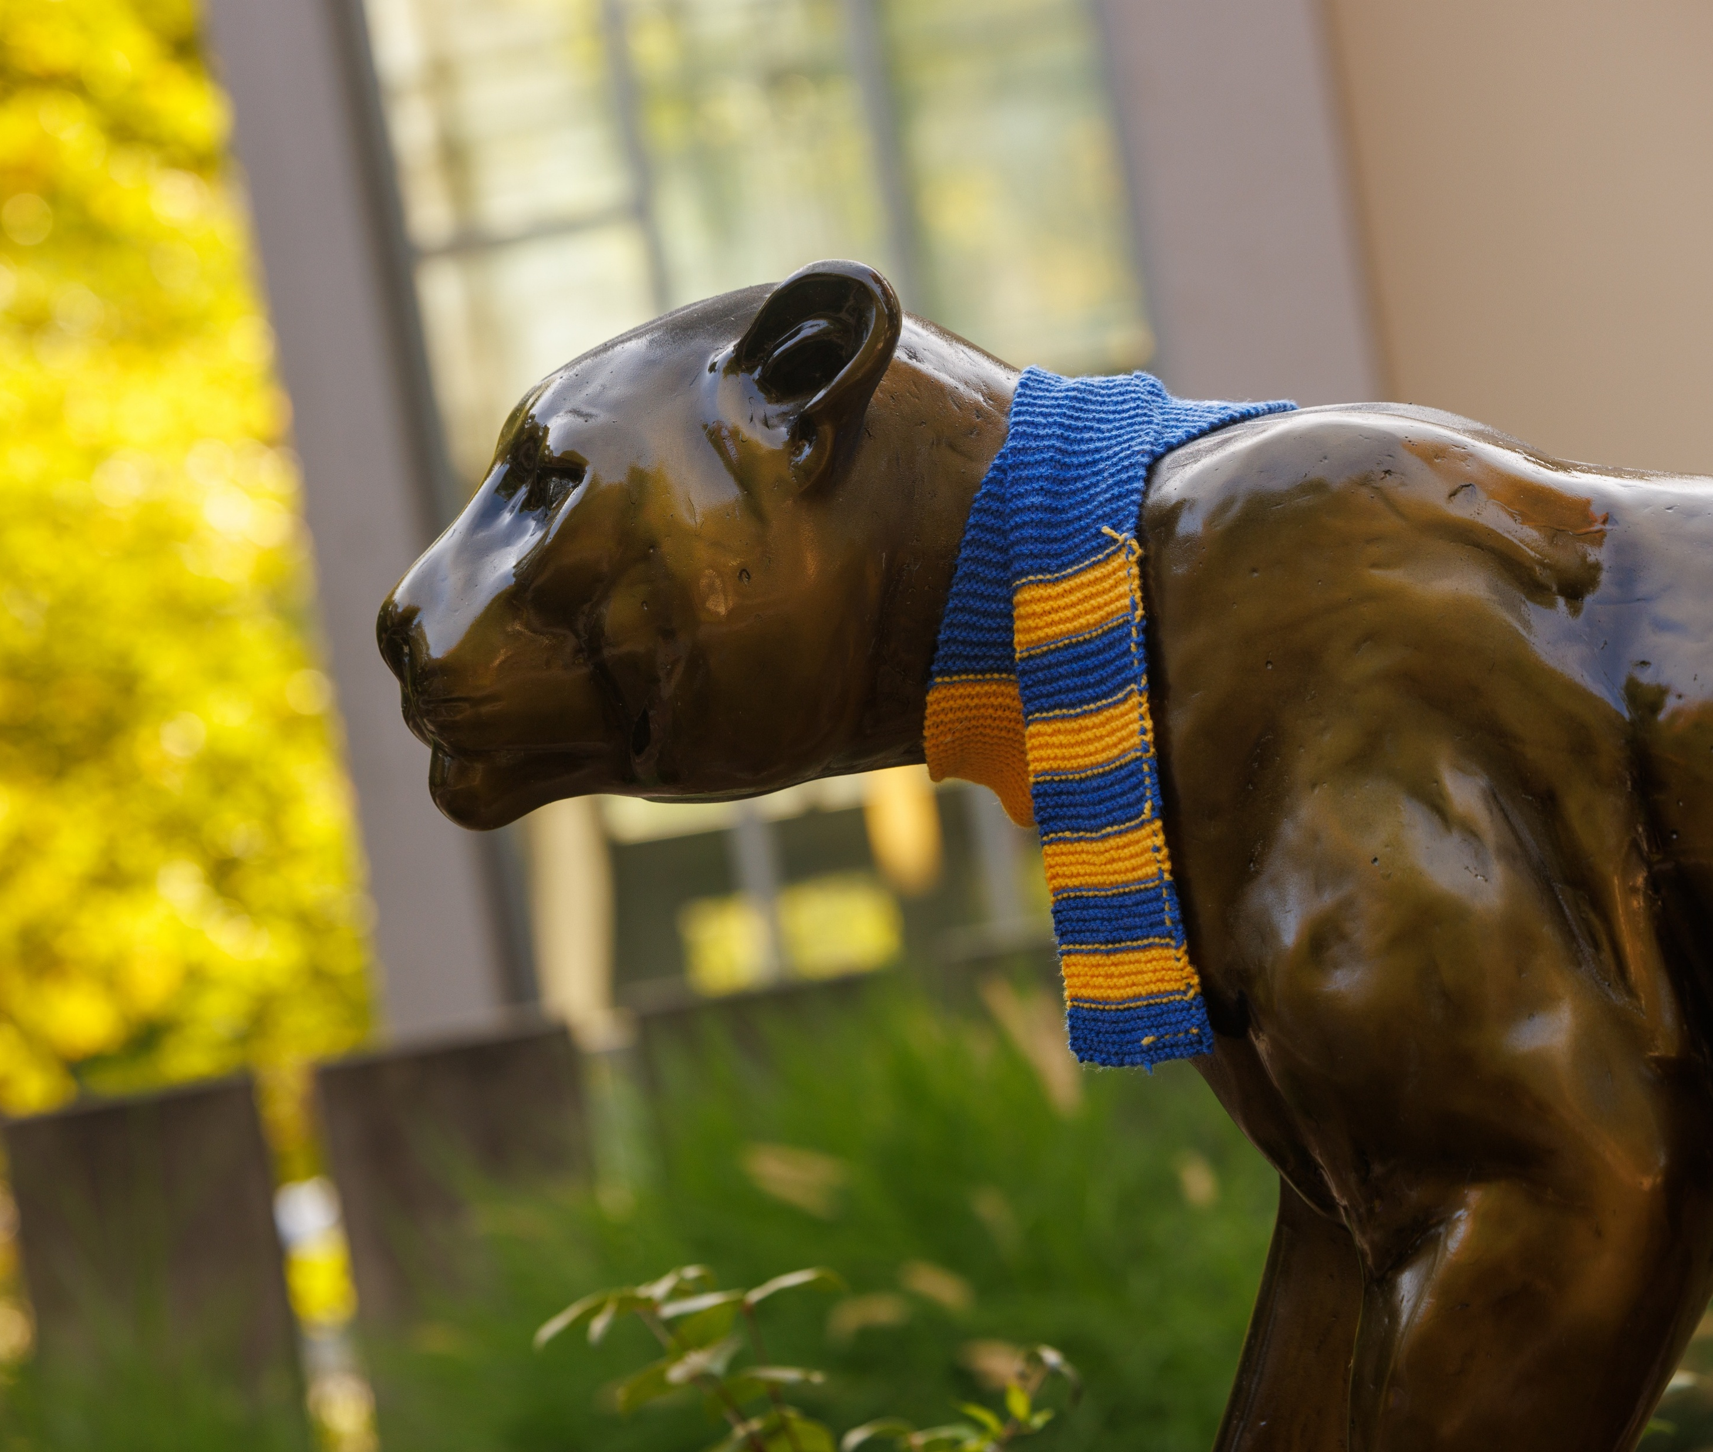
Goal 1: Liberal Arts Mission
Launched a strategic, personalized communications initiative within Slate to reduce summer melt and improve transfer conversion
Researched and developed new financial aid awarding parameters to better utilize institutional, state, and federal student aid to support students and enhance recruitment efforts
Launched a comprehensive, institution-wide market research and brand study to establish a data-driven foundation for future strategic planning
Notes:
Carolyn/Jana

Slide 10
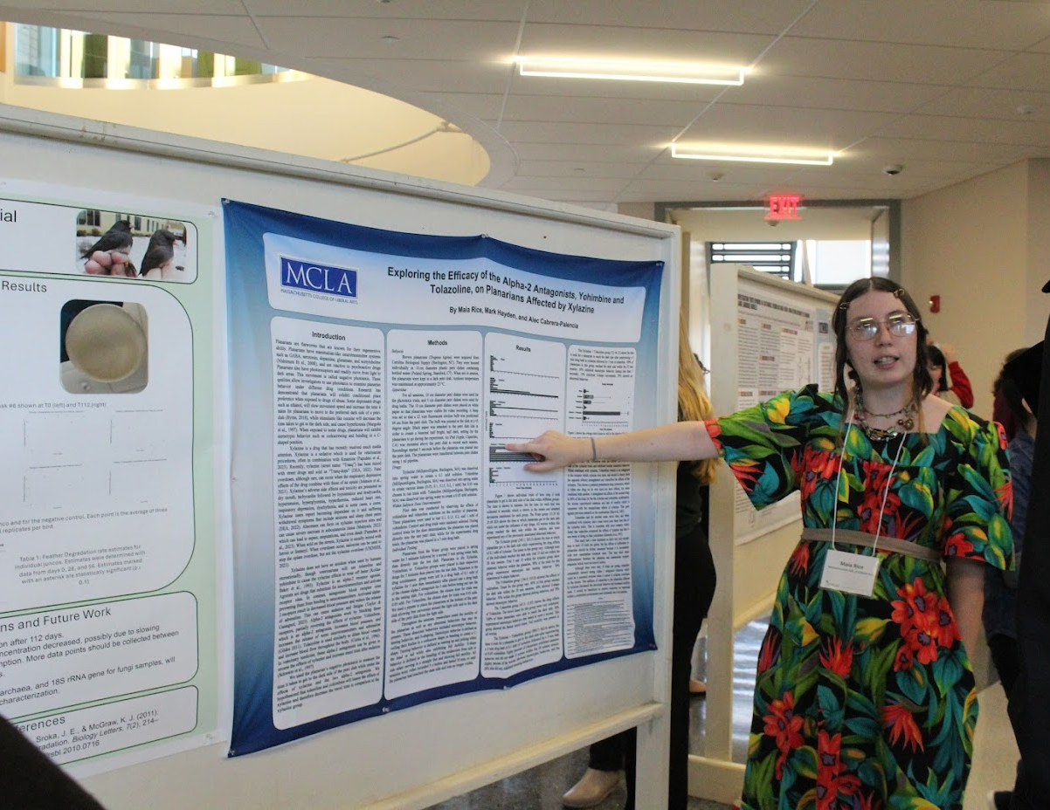
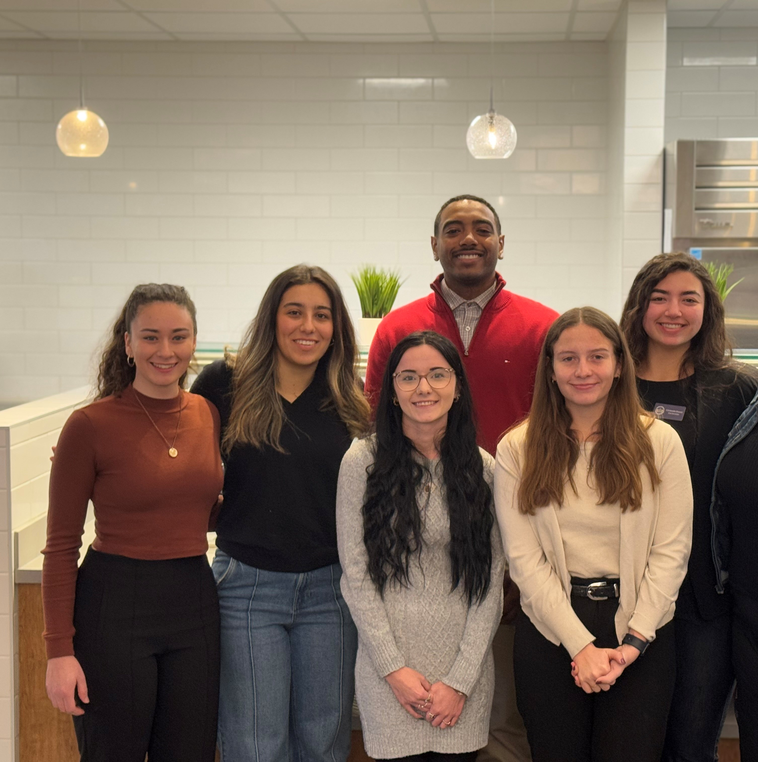
Goal 2: Increase Access, Equity and Success
Developed and charged a campuswide, Council on Diversity, Equity, and Inclusion
Explored the framework of the Okanagan Charter
Examined MCLA's current framework and resources for curricular and co-curricular, High Impact Educational Practices (HIPs)
Initiated steps towards HIP designation listing for curricular offerings in the course catalog
Completed Campus Climate Survey and focus groups.
Began reinvigoration of Community-Based Learning programs
Notes:
Patrick/Lynn

Slide 11
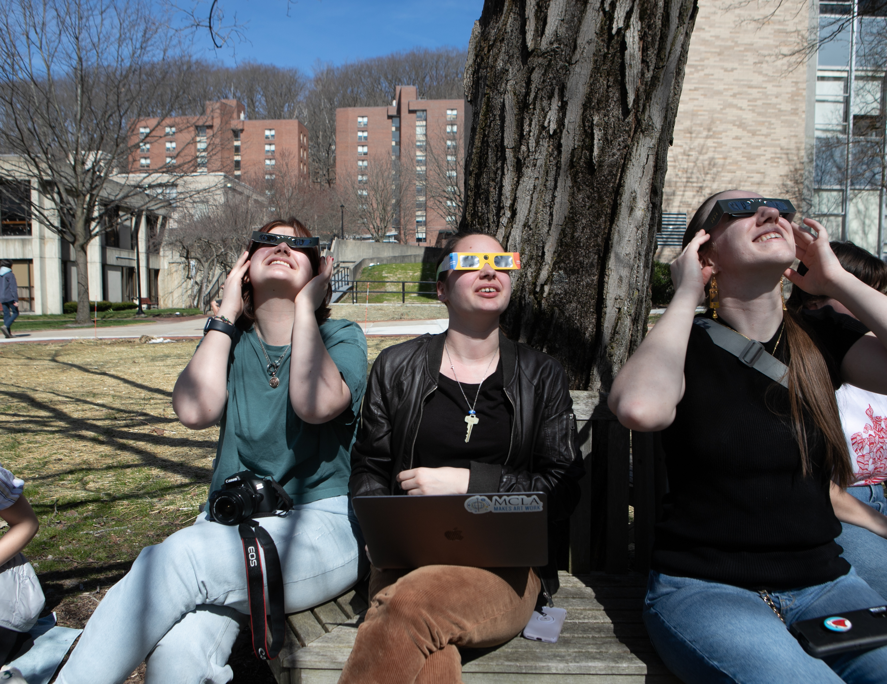
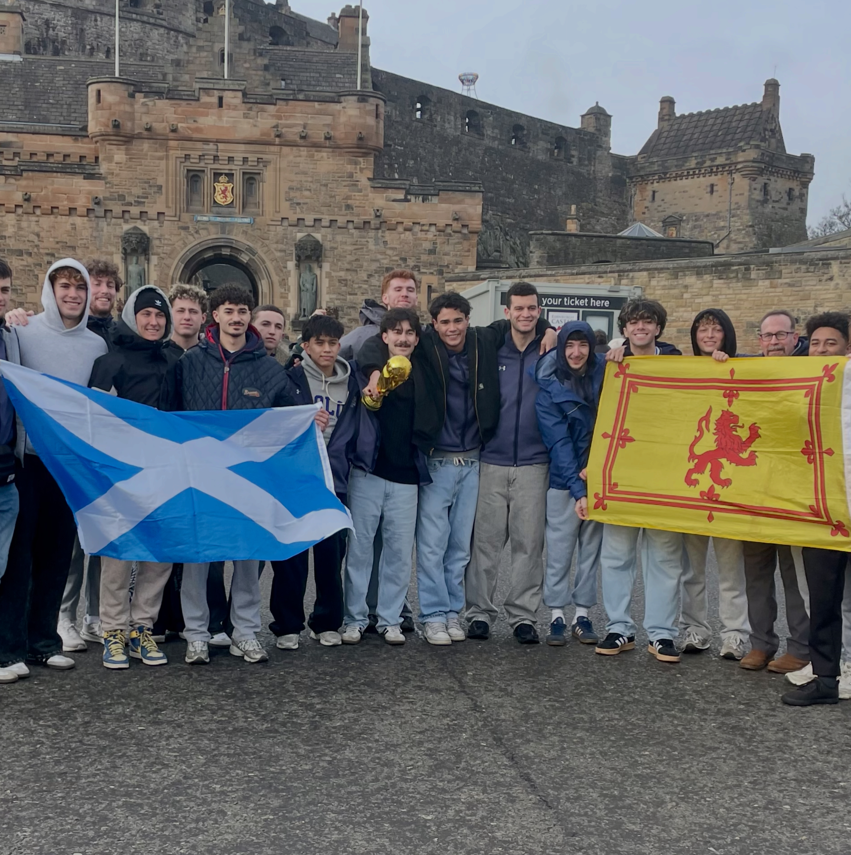

Goal 2: Increase Access, Equity and Success
Began development of an experiential transcript
Piloted no cost educational materials in selected classes
Continued work to make all course materials fully accessible to all students
Enhanced civic engagement offerings for MCLA students to make connections with the North Adams community
Built opportunities for student volunteerism within the North Adam Public Schools system
Developed a database of contacts for community engagement partners
Notes:
Patrick/Lynn

Slide 12
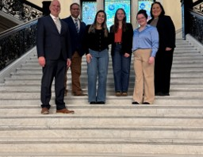
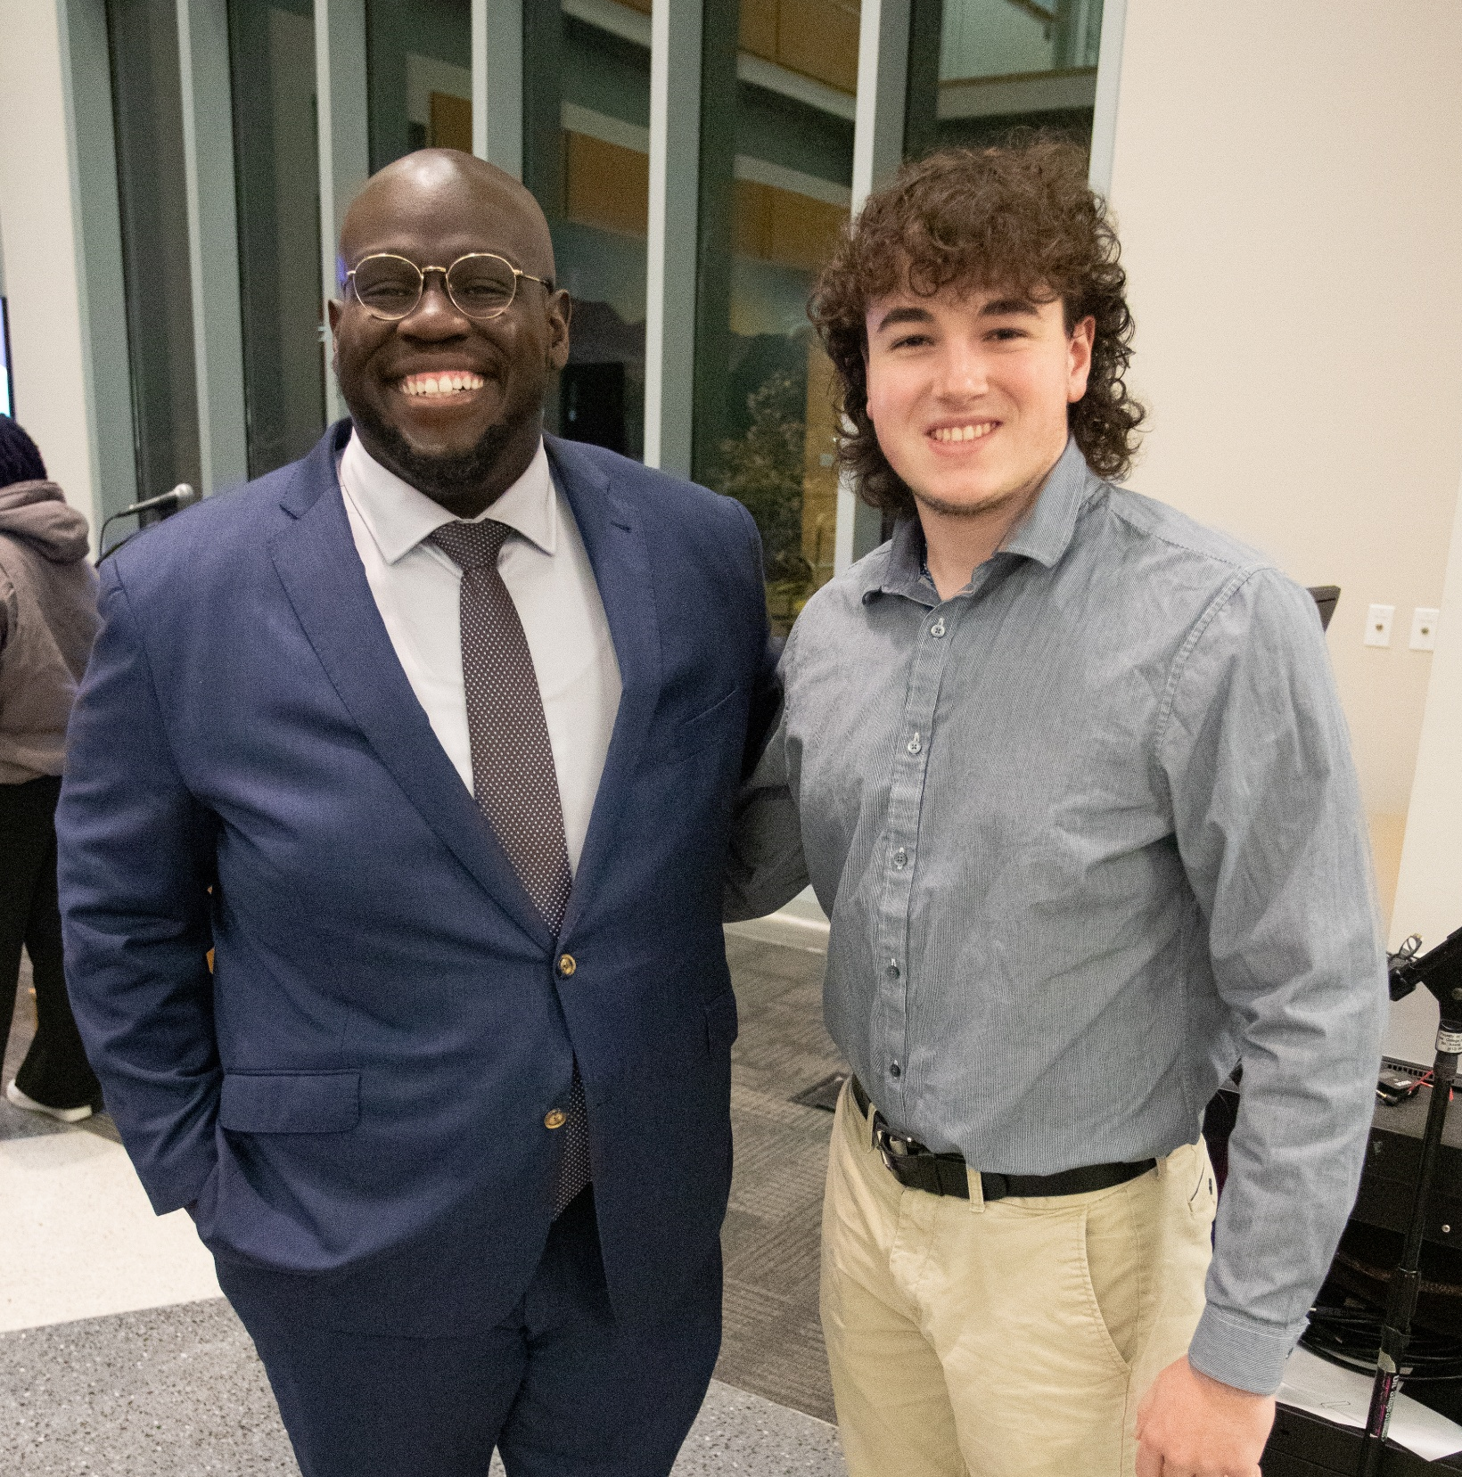
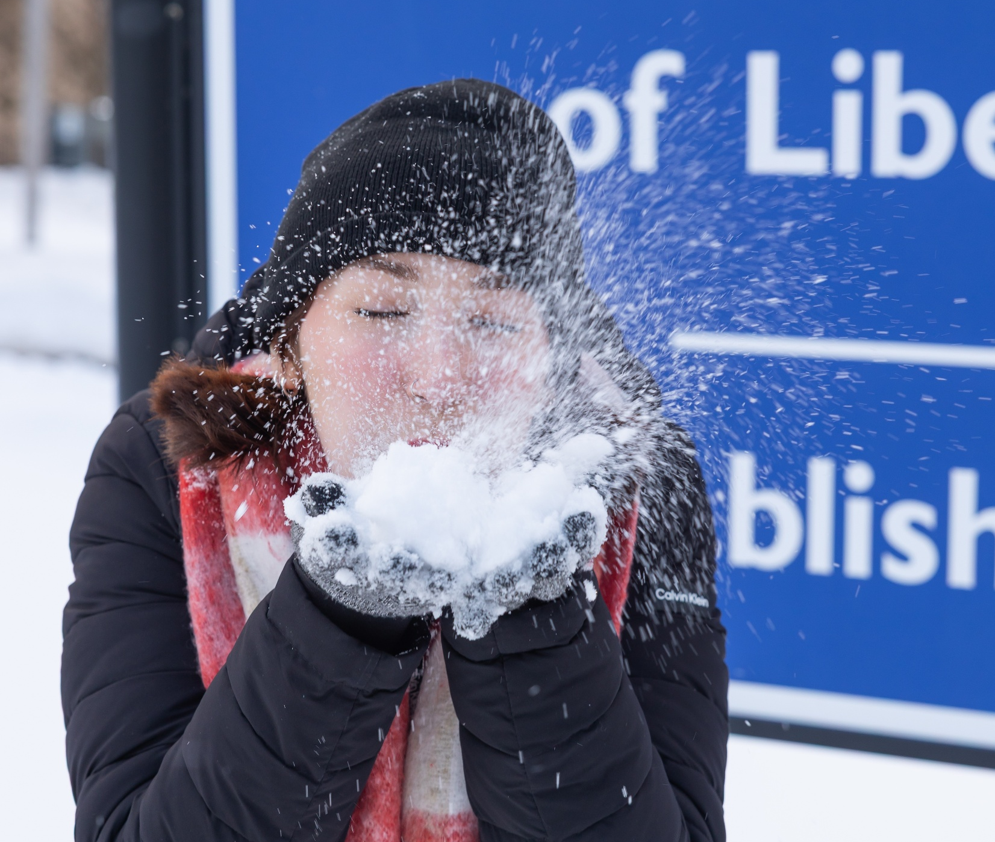
Goal 3: Enhance the Student Experience
Reestablished key Academic & Student Affairs partnership to relaunch community-based Learning Programs
Identified key MCLA milestones and created a Pathway Map students should complete during their time at the College
Partnered with DCAMM to a develop a comprehensive multi-year Campus Master Plan
Reviewed student programming models at peer institutions to maximize MCLA’s engagement and retention
Engaged with national organization (NASPA) to evaluate Student Affairs staffing models, review organizational structures and key programs supporting student engagement
Notes:
Luke/Laura

Slide 13
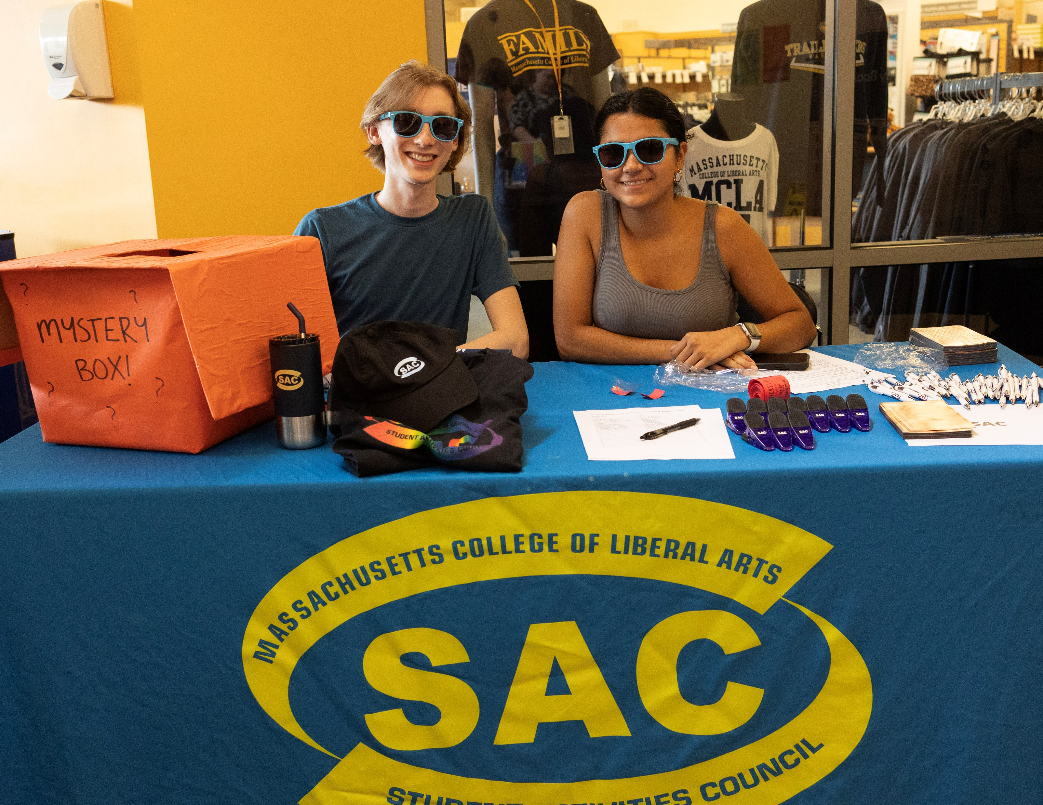
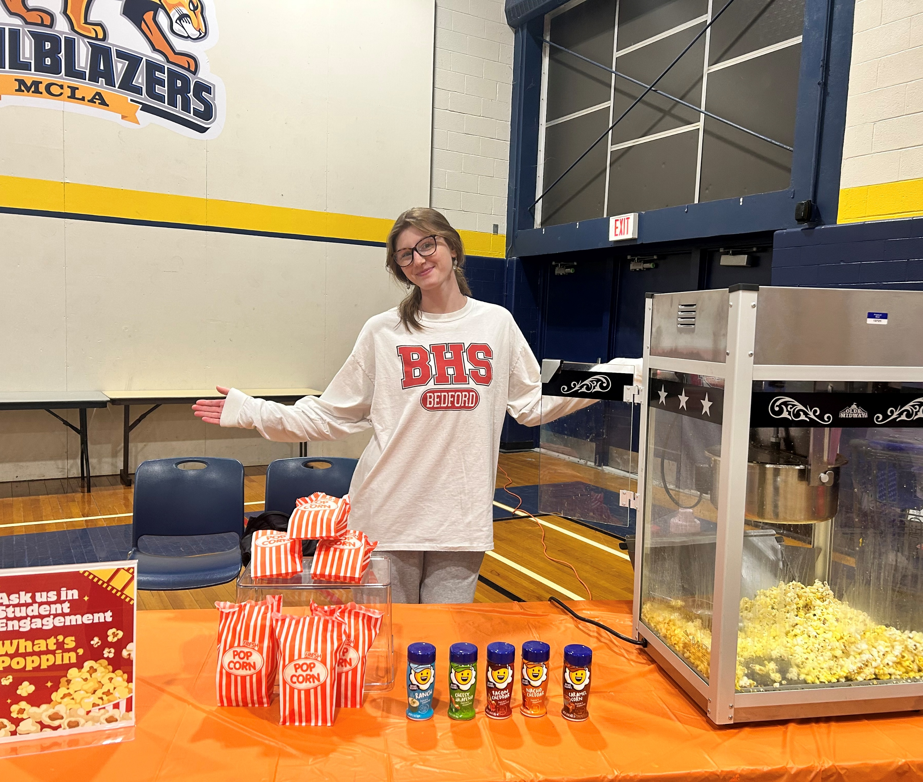
Goal 3: Enhance the Student Experience
Launched centralized campus calendar and student engagement programming platform
Partnered with Student Government Association to develop an institution wide inclusive based definition of student leadership
Through SGA developed mechanism that is monitored and responded to remotely and in-person for students to share views and provide feedback
Further development and utilization of the annual dining survey to continue to identify new dining options and best meet student needs
Notes:
/Laura

Slide 14
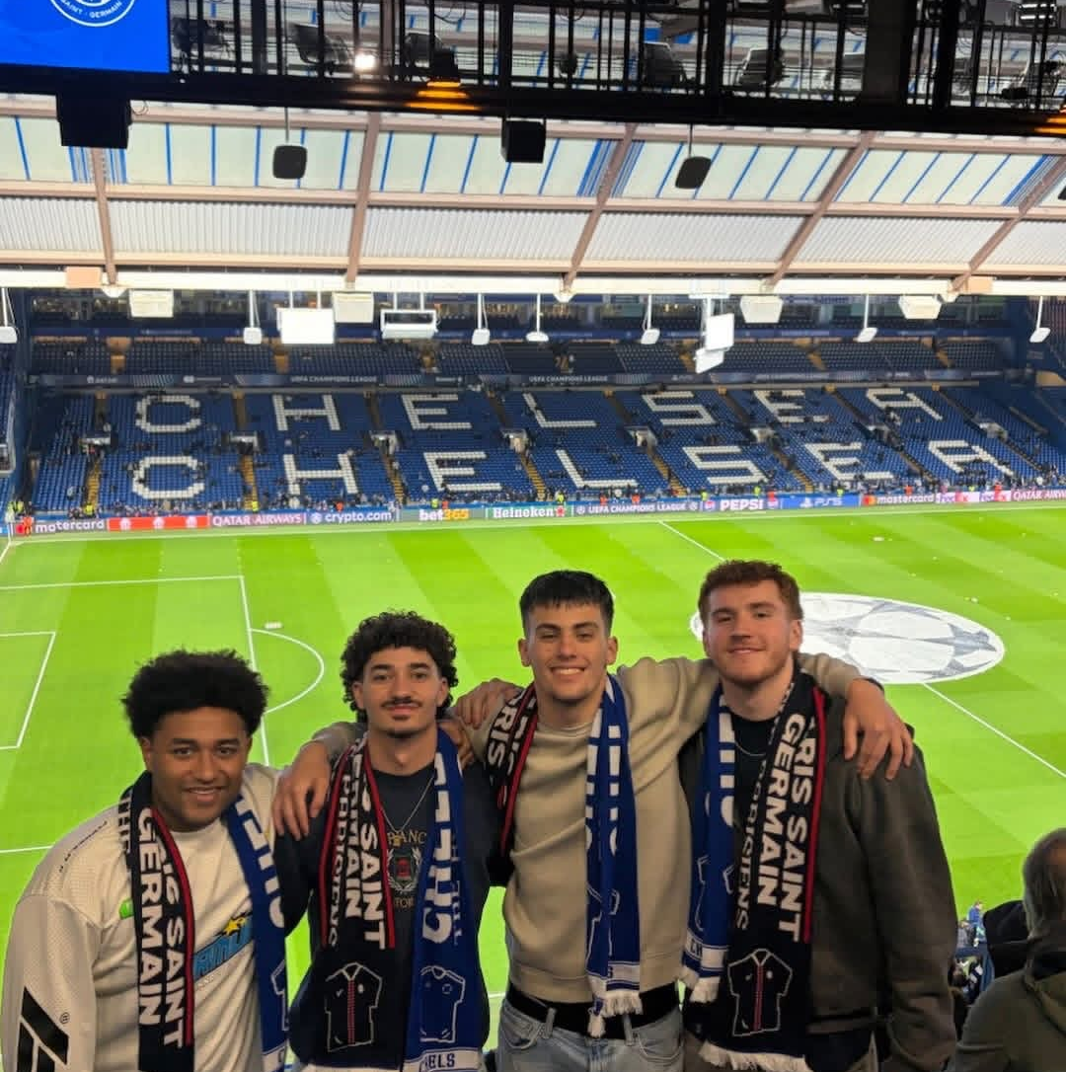
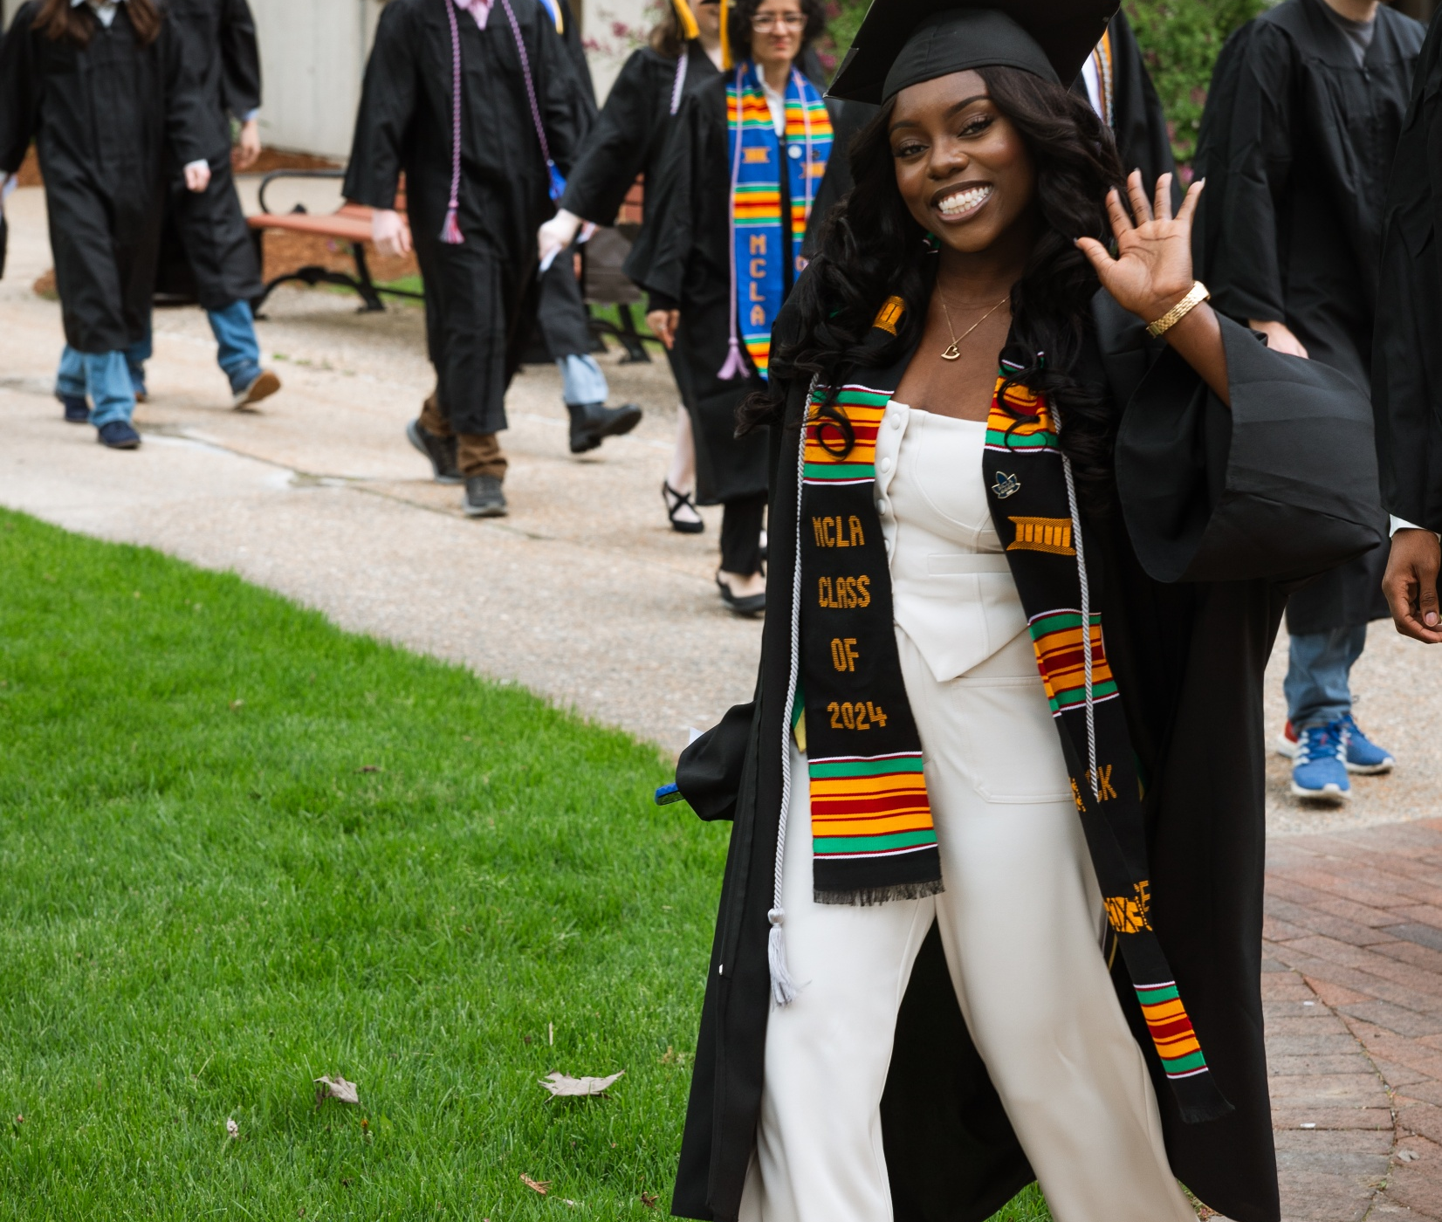
Looking Forward: Next Year
Finalize and advance the College’s updated mission and institutional learning outcomes
Initiate discussions with DHE to explore specialty institution designation (e.g., MassArt, Mass Maritime)
Align the College’s budget with mission, values, and enrollment-driven priorities
Grow non‑tuition revenue through facilities rentals, professional development, and state funding opportunities
Maintain ongoing website modernization to ensure accuracy, accessibility, and thoughtful AI integration
Launch a refreshed brand identity and user-centered website redesign aligned with institutional priorities
Partner with brand agency to develop a long-term marketing plan
Create updated marketing materials that clearly convey MCLA’s mission, values, and impact to key audiences
Notes:
Carolyn

Slide 15
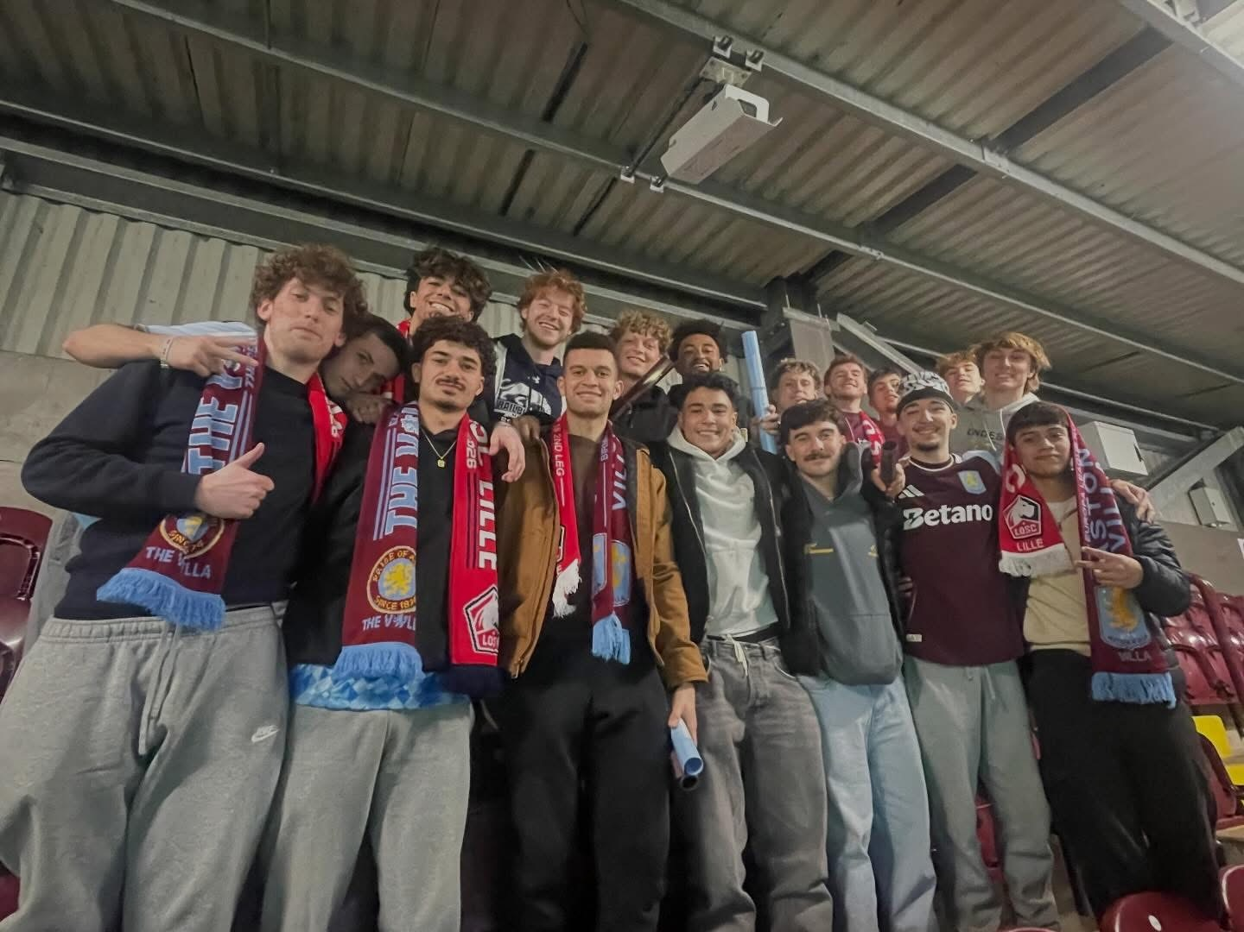
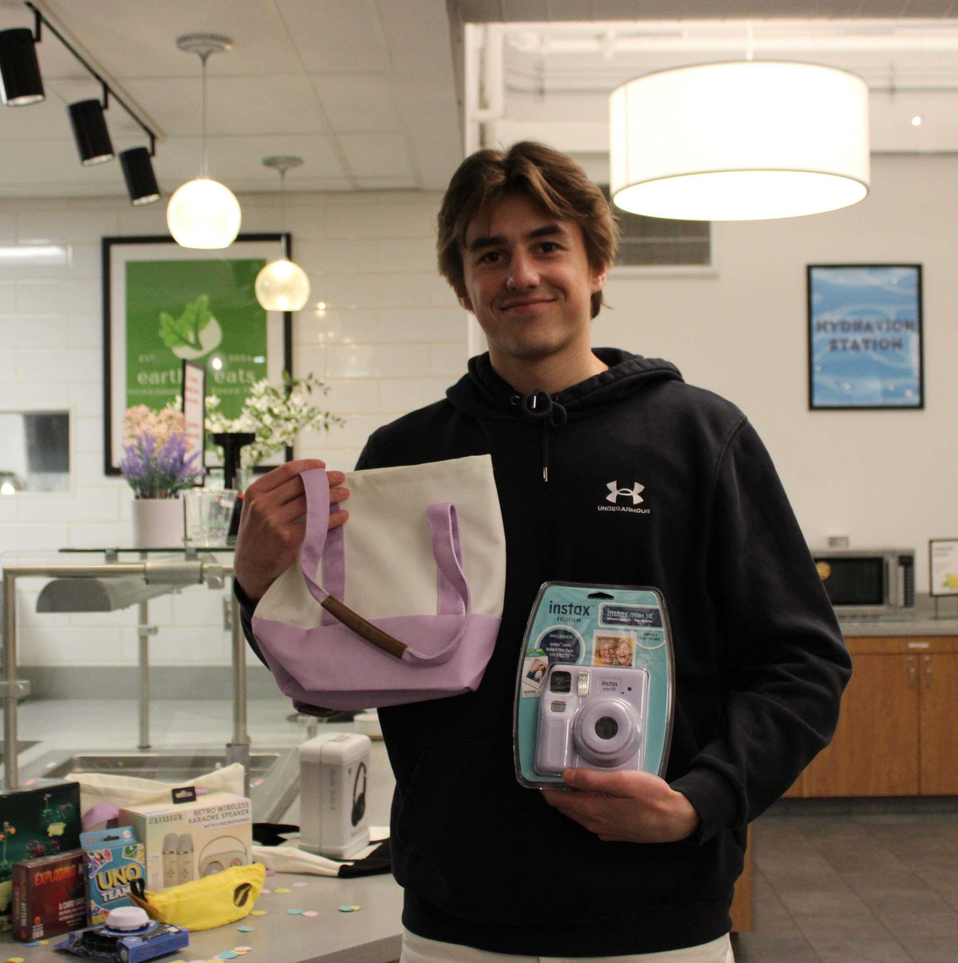
Looking Forward: Next Year
Launch the Council on Diversity, Equity, and Inclusion and its charge
Adopt and advance the Okanagan Charter
Expand campus support for High Impact Practices. Deepen involvement and engagement of departments and CTL
Develop and launch a Summer Bridge program
Define key milestones MCLA students should achieve during their time at the College and develop a clear pathway that guides students
Pilot campus transportation plan
Revitalize community-based and Civic Learning programs
Refresh student social and gathering spaces across campus
Notes:
Lynn

Slide 16
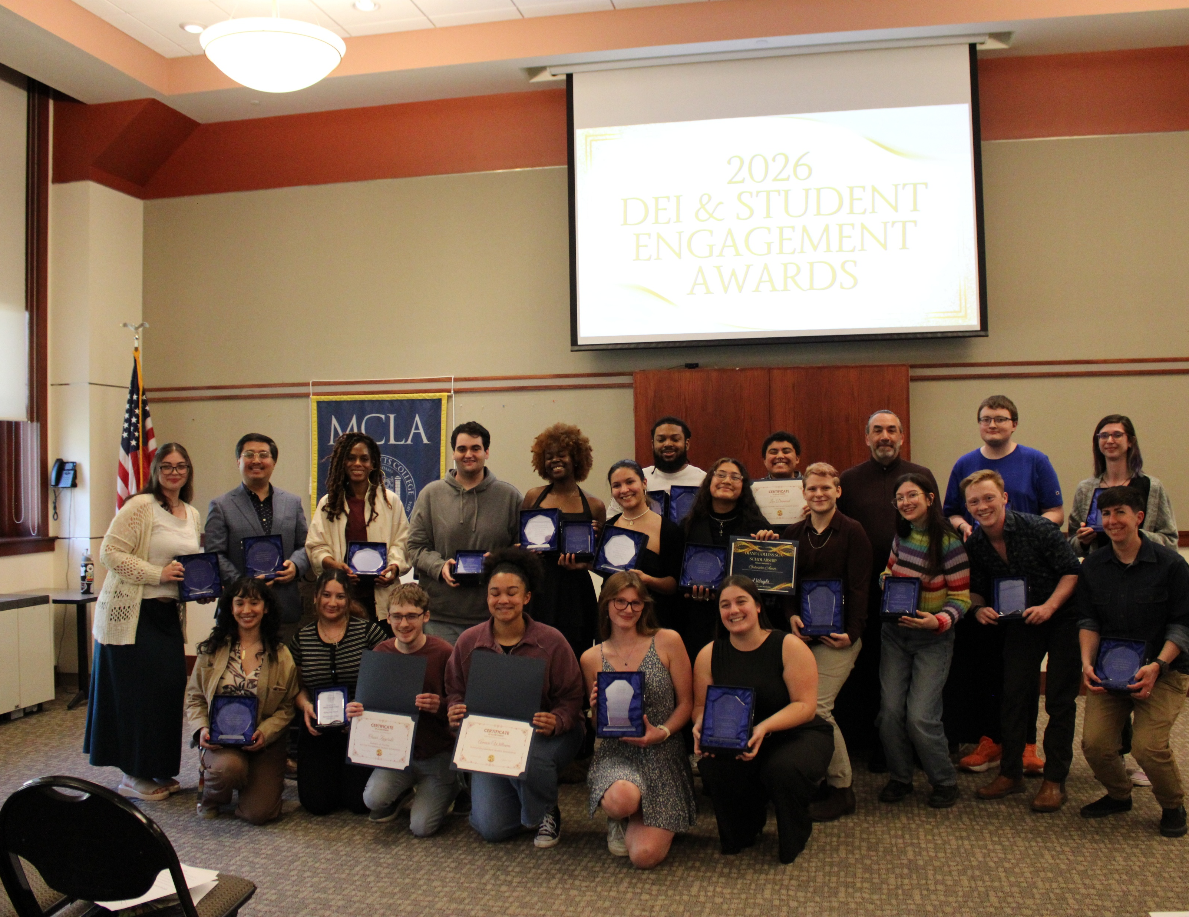
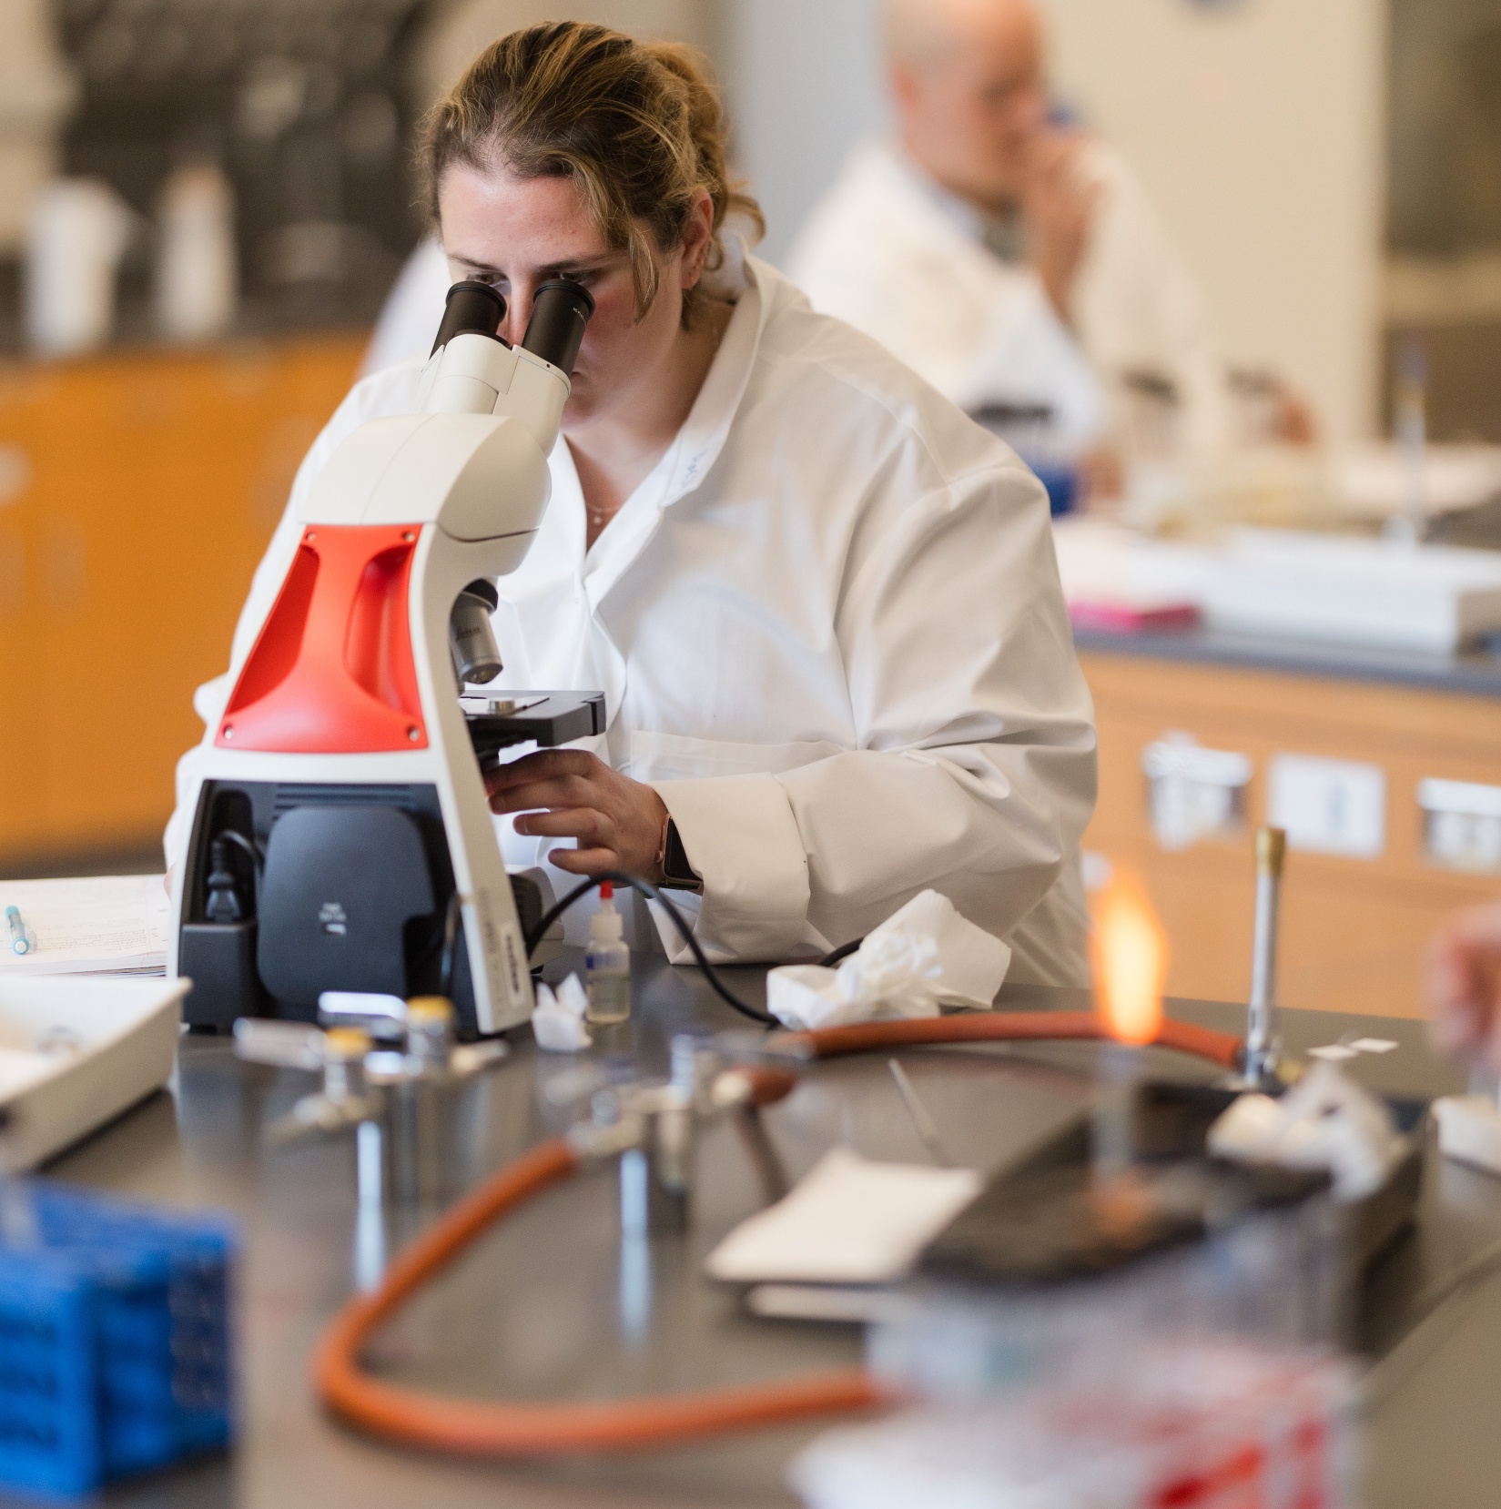
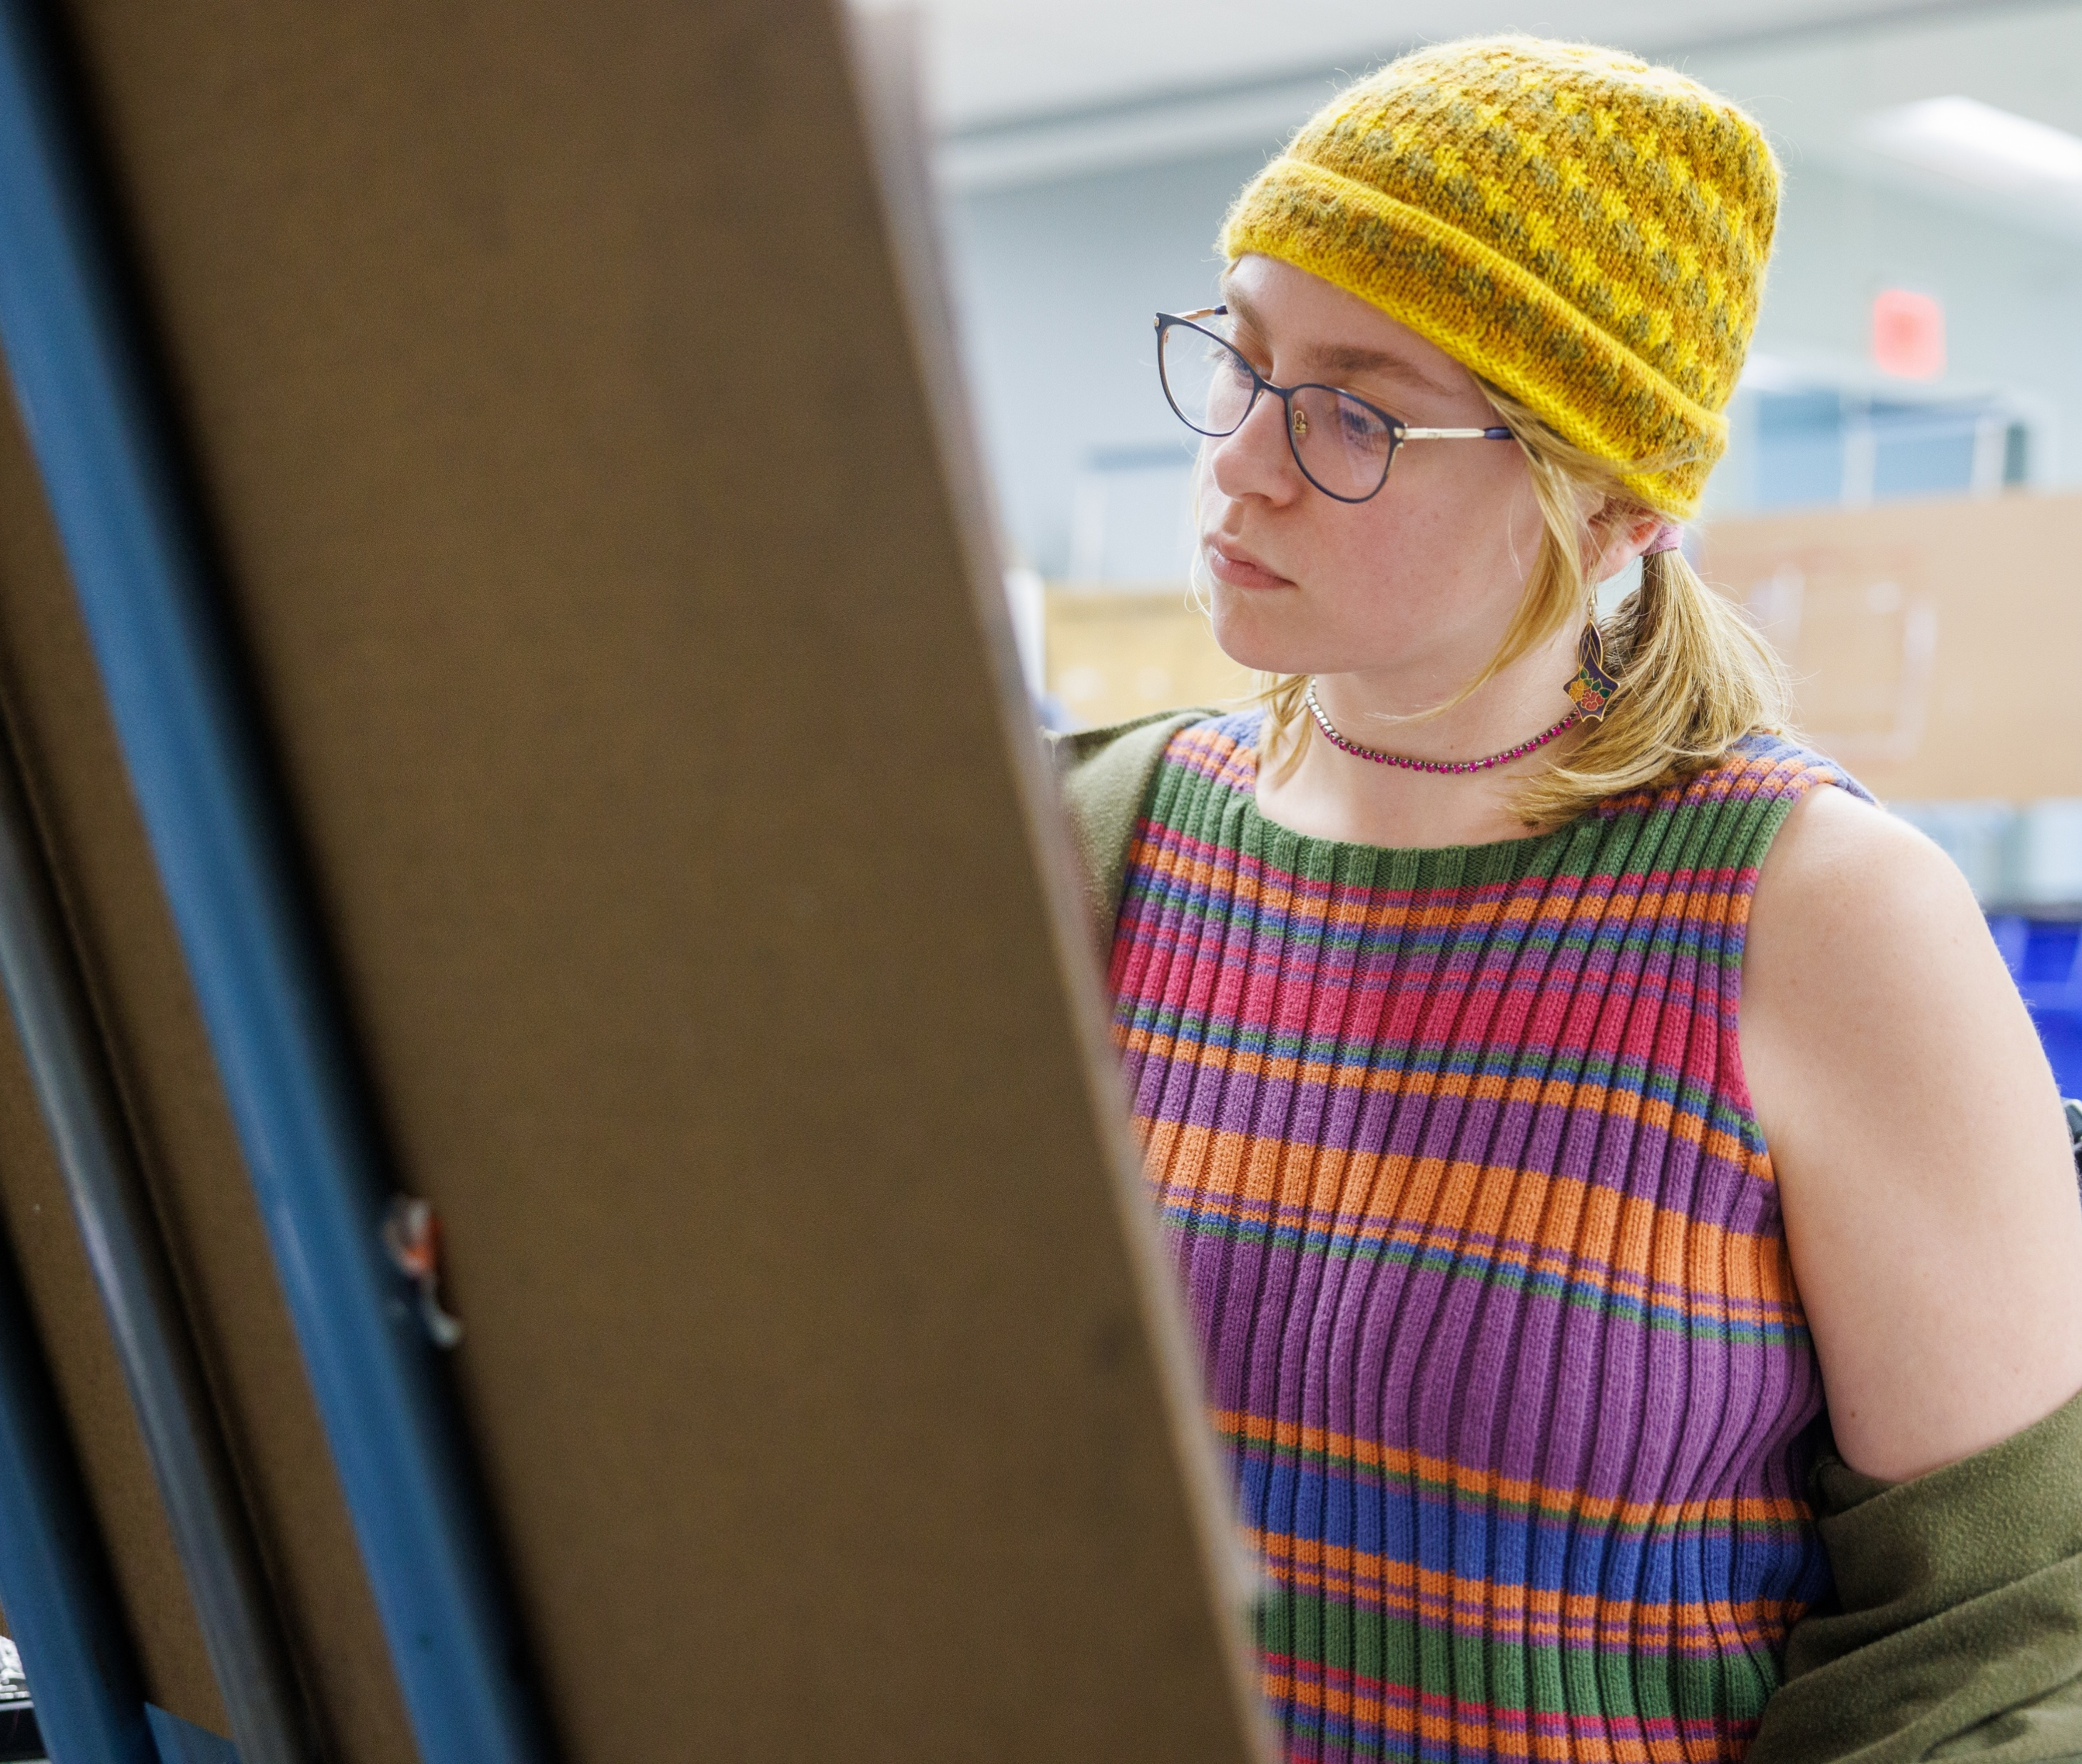
Looking Forward: Next Year
Continue institutional progress in making all course materials low or no cost and fully accessible
Create a student employment program that helps students develop essential skills
Develop a Transfer Success Coaching program
Strengthen relationships with Community Colleges to increase the transfer pipeline
Enhance leadership program offerings for all students
Enrich social programming offerings including late-night and weekend events and additional engagement opportunities as well as programming to better support commuters and first-generation students
Reestablish MCLA’s Racial Equity Summit
Notes:
Patrick

Slide 17
Mission Statement & Learning Outcomes
Notes:
Carolyn

Slide 18
Mission Statement Working Group
Staff
Carolyn Dehner
Justina Trova
Logan Keyes
Ruby Vega
Pete Hoyt
Laura Standley
Jeremy Winchester
Tom Byrne
Masyn Lavariere
Allie Bayer
Bristol Sternfield '21
Colby Harvish '16
Tim Callahan
Faculty
Students
Alumni
Community member
Notes:
Carolyn

Slide 19
Mission Statement
Current mission statement:
Massachusetts College of Liberal Arts (MCLA) is the Commonwealth's public liberal arts college and a campus of the Massachusetts state university system. MCLA promotes excellence in learning and teaching, innovative scholarship, intellectual creativity, public service, applied knowledge, and active and responsible citizenship. MCLA prepares its graduates to be practical problem solvers and engaged, resilient global citizens.
Revised mission statement:
MCLA offers a student-centered and accessible public liberal arts education within an inclusive community. With a focus on close mentorship, interdisciplinary studies, and experiential learning, MCLA prepares graduates to successfully adapt and thrive in a changing world.
Notes:
Questions for audience:
Does this accurately represent MCLA?
Does the statement capture who we are?

Slide 20

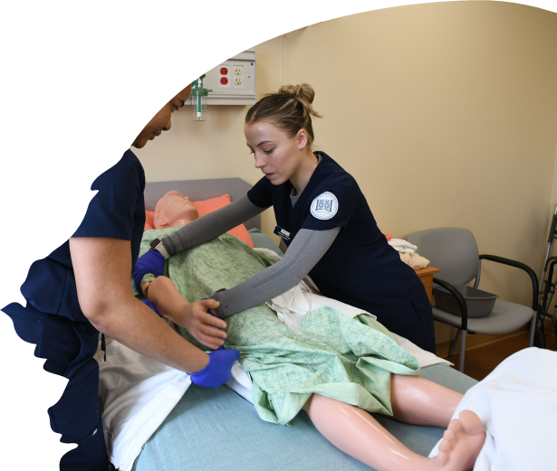
Mission Statement
Is this our why?
What does this say about MCLA’s ambitions as a
public liberal arts college?
Does this differentiate us from our competitors?
How?
Does this reflect what we are passionate about at MCLA?
Will this create campus alignment and agreement?
Will this resonate with our target audiences?
Notes:
Carolyn – then breakouts
Ask each table to take notes – bring paper and pens
Can paste questions in chat

Slide 21
Mission Statement
Instructions:
As you exit 218, please take a raffle ticket which has your room number on it. Go to that space to meet your group. Using the handouts provided in each room, answer the questions fully. Identify a note taker to capture the group’s discussion. We will collect your notes at the end of the session. You will have approximately 15 minutes for your discussion.
Breakout rooms available:
Room 218
Room 213
Room 216
Room 208
Room 203
Room 201
Notes:
Patrick

Slide 22
Learning Outcomes
1. Communicate and Connect
Students will effectively communicate and present ideas with clarity, intention, and confidence for diverse audiences and cultures; listen and respond to promote mutual understanding; and use creative, visual, and human‑centered digital strategies to enhance meaning.
2. Think Critically and Identify/Solve Problems
Students will understand the foundational components of systems and fields of knowledge; develop the skills to examine and question assumptions within them; and propose a solution/resolution.
3. Collaborate and Lead
Students will become transformative change makers by collaborating, providing meaningful contributions, and supporting others.
Notes:
Patrick
(print 20 copies – 2 for each table)

Slide 23
Learning Outcomes
4. Adapt and Keep Growing
Students will utilize feedback to widen their perspective, take initiative in new or challenging environments, and demonstrate resilience when faced with change.
5. Understand Yourself and the World
Students will cultivate self-awareness and a sense of purpose, informed by an understanding of ethical decision-making and social responsibility in an interconnected world.
Notes:
Patrick

Slide 24
Learning Outcomes
Do the outcomes clearly identify the knowledge, skills, and dispositions that students should be able to demonstrate during their time at MCLA?
Are the outcomes aligned with elements of the Core, departments, and graduate learning?
Do the outcomes represent learners as active participants and partners in their own education and that of others?
Are the outcomes observable and stated in assessable terms of what students should know and be able to do (i.e., can they be demonstrated with evidence of student work)?
Does the language of the outcomes elicit ideas of concrete assignments or experiences through which students could demonstrate the knowledge or skill?
Do the outcomes indicate a degree of academic rigor or level of student performance and achievement?
Notes:
Patrick – paste questions in the chat?
Note taker for the table – bring paper and pen
Report out

Slide 25
Learning Outcomes
Instructions:
Return to the same room where your group met for the mission statement breakout. Using the handouts provided in each room, answer the questions fully. Identify a note taker to capture the group’s discussion. We will collect your notes at the end of the session. You will have approximately 15 minutes for your discussion.
Breakout rooms available:
Room 218
Room 213
Room 216
Room 208
Room 203
Room 201
Notes:
Patrick

Slide 26
“I am confident that we will work together as a community to advance these goals and enhance the positive impact MCLA already has – on our students and their families, our 21,000
alumni, our faculty and staff, our city and the region, as well
as the Commonwealth.”
President James F. Birge
Notes:
PJB - closing

Slide 27
Thank you
Have a great summer!
Notes:
PJB - closing

